Slide 1

INSERTION Sort
Presented by:
Sianoya, Alria
Manalo, John Paulo
Villapando, Raiden
Pines, Shaine Ella

Slide 2

WHAT IS INSERTION SORT?
Insertion Sort is a simple sorting algorithm that builds the final sorted array (or list) one item at a time. It works similarly to the way you sort playing cards in your hands. The algorithm iteratively takes an element from the unsorted portion and places it in its correct position in the sorted portion.

Slide 3

STEPS AND CHARCTERISTICS
Steps:
Characteristics:
Start with the second element (index 1) since the first one (index 0) is already "sorted."
Compare the current element with elements before it.
Shift larger elements one position to the right to make space for the current element.
Insert the current element in the correct position.
Repeat for all elements in the list.
Time Complexity:
- Best Case (Already Sorted): O(n)
-Average/Worst Case (Reversed Order): O(n^2)
Space Complexity: O(1) (In-place sorting)
Stable and simple to implement particularly for small datasets.

Slide 4
APPLICATIONS
1. Sorting Playlist:
By Title: Alphabetically sort songs by their titles.
By Artist: Group and sort songs based on artist’ names.
2. Adding a New Song:
In a maintained playlist, Insertion Sort can efficiently place a new song in its correct position without re-sorting the entire list.
3. Sorting Player Scores:
Maintain a leaderboard where player scores are updated. New scores can be inserted into their correct positions without re-sorting the entire list.
4. Organizing Student Records:
Grades:
- Sort students’ grades in ascending or descending order to identify rankings or ranges (e.g., pass vs. fail).
Attendance:
- Sort Attendance records alphabetically or by the number of days attended.
Assignment:
- Organize submissions by date and time to check the order of submission.
5. Sorting Exam Results:
Ranking Students by Marks:
- Insertion Sort can help rank students based on their performance in exams or quizzes for smaller class sizes.

Slide 5
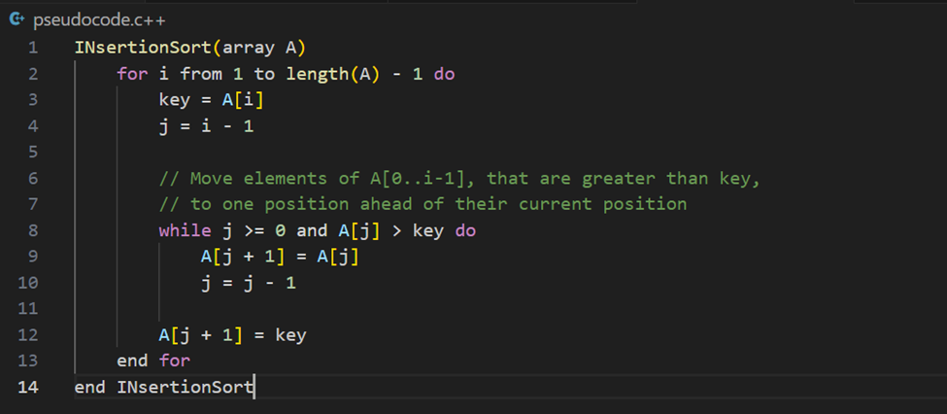
PSEUDOCODE EXAMPLE

Slide 6
EXAMPLE
Initial Array: [7, 3, 8, 4, 2]
Start with ‘i = 1’ (key = 3):
Array now: [3, 7, 8, 4, 2]
Next, ‘i = 2’ (key = 8):
Array remains: [3, 7, 8, 4, 2]
Next, ‘i = 3’ (key = 4):
Array now: [3, 4, 7, 8, 2]
Finally, ‘i = 4’ (key = 2);
Array now: [2, 3, 4, 7, 8]
Final Sorted Array: [2, 3, 4, 7, 8]

Slide 7
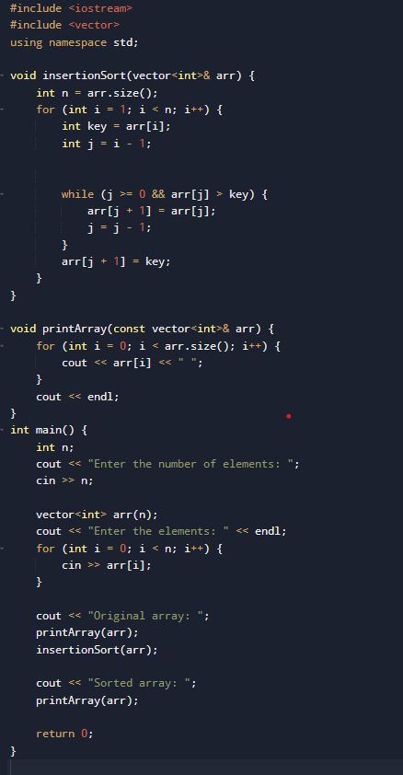
SOURCE CODE

Slide 8
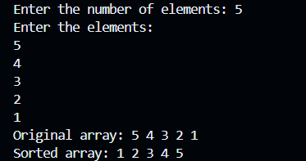
SOURCE CODE
OUTPUT:

Slide 9
THANK YOU!

